Slide 1
Introduction to Angular 2 version 14.0
Sarita Lad
31 march 2022

Slide 2
What is Angular?
Angular is nothing but a framework that is used by app development companies to create dynamic web apps. It allows the developers to use HTML as the template language and also enables them to extend the HTML’s syntax to express the components of the application.
Angular minimizes the impedance mismatch between what an app requires by developing new HTML constructs and document-centric HTML. It teaches the browser a syntax that helps in calling directives. For instance -
DOM handles structures for showing, hiding, and repeating DOM fragments.
Data binding
HTML grouping
Support for form validation and forms

Slide 3
features of Angular 14
Angular enables the developers in creating dynamic web apps and single-page apps (SAPs).
With the use of AngularJS, one does not need to rely on third-party libraries for creating applications. This framework has multiple benefits like -
Browser Compatibility
Typescript Compatibility
Bug Fixes
Date Range Picker
Angular NPM
Router
Async Locker Timeouts
Localization
Empty return pf resolver
NGCC
Core
Deprecation

Slide 4
How to install Angular CLI 14 to your system?
The first step is to install the latest version of Angular CLI. Let’s install Angular CLI 10, the newest version on your machine. To do so, run the following commands -
npm install -g @angular/cli
ng new test-app-project
cd test-test-project
ng serve
2. Now, in the new command-line interface, run the command -
$npm install -g @angular/cli@14
(this command will install angular/cli v14.0.0.0.0)
3 Then to create a new Angular project, run the following command in your terminal.
$ cd ~$ ng new myfirstproject

Slide 5
Building blocks in Angular
Components
Modules
Directives
Decorators
Pipes
Data Binding
Templates
Metadata
Services
Dependency Injection

Slide 6
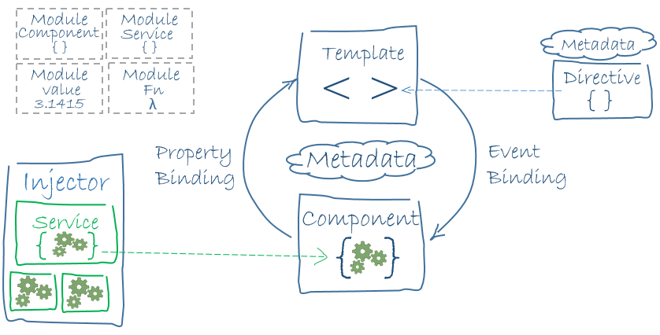
Basic Architecture of an Angular Application

Slide 7
The Eight main building blocks of an Angular application:
Modules
Components
Templates
Metadata
Data binding
Directives
Services
Dependency injection

Slide 8
Components
Every Angular project has at least one component, the root component and root component connects the component hierarchy with a page document object model (DOM). Each component defines the class that contains application data and logic, and it is associated with the HTML template that defines the view to be displayed in a target app. A component controls a patch of screen called a view.
The @Component decorator identifies the class immediately below it as the component and provides the template and related component-specific metadata.

Slide 9
Angular libraries
Angular ships as a collection of JavaScript modules. You can think of them as library modules.
Each Angular library name begins with the @angular prefix.
You install them with the npm package manager and import parts of them with JavaScript import statements.
import { Component } from '@angular/core';
You also import Angular modules from Angular libraries using JavaScript import statements:
import { BrowserModule } from '@angular/platform-browser';

Slide 10
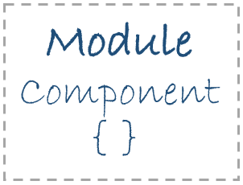
Modules
Every Angular app has a root module, conventionally named AppModule, which provides the bootstrap mechanism that launches the application. An app typically contains many functional modules.
If we want to use another custom Angular module, then we need to register that module inside the app.module.ts file. Organizing your code into distinct functional modules helps in managing the development of complex applications, and in designing for re usability.

Slide 11
Key features of Angular 2
Components − The earlier version of Angular had a focus of Controllers but now has changed the focus to having components over controllers. Components help to build the applications into many modules. This helps in better maintaining the application over a period of time.
TypeScript − The newer version of Angular is based on TypeScript. This is a superset of JavaScript and is maintained by Microsoft.
Services − Services are a set of code that can be shared by different components of an application. So for example if you had a data component that picked data from a database, you could have it as a shared service that could be used across multiple applications.

Slide 12
What is Angular 2 ?
In the world of web development, Angular is a popular term that we come across. It is an open-source front-end application development platform.
Angular is a web application development platform that has made the life of developers simple.
It has combined declarative templates (meaning that we simply state what we want to be bound and used and let the framework figure out the rest), dependency injection (a technique where one object has delegated the responsibility of handling the dependencies of another), end-to-end tooling, & integrated best practices to ease development problems.
It also helps us build applications that reside on the web, our mobiles, or our desktops.

Slide 13
What is Angular CLI?
Angular CLI stands for the ‘command line interface’. It is an interface used to scaffold and develop Angular apps using node.js style modules.
It handles all the common tedious tasks in addition to providing us with a scalable project structure.
One of the advantages of using Angular CLI is that the time needed for installing and configuring the necessary dependencies and wiring everything together reduces significantly.

Slide 14
Grammar :naming convensions:
1. File structure conventions
The guideline uses the shortcut hero.component.ts|html|css|spec to represent those various files. Using this shortcut makes this guide’s file structures easier to read and more terse.
2. Single responsibility
A class should have one and only one reason to change meaning that a class should have only one job.
Do define one thing such as a service or component per file
One component per file makes it far easier to read, maintain, and avoid collisions with teams in source control.
3. Naming
3.1 Naming conventions are hugely important to maintainability and readability. The recommended pattern is feature.type.ts.
3.2 Separate filenames with dots and dashes
Do use conventional type names including .service, .component, .pipe, .module, and .directive. Invent additional type names if you must but take care not to create too many.
3.3 Symbols and file names
Do use upper camel case for class names.
Do match the name of the symbol to the name of the file.
Do give the filename the conventional suffix (such as .component.ts, .directive.ts, .module.ts, .pipe.ts, or .service.ts) for a file of that type.

Slide 15
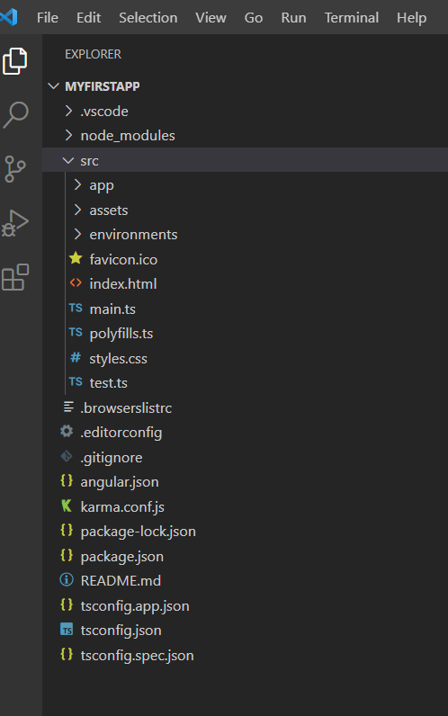
Basic Structure Of An Angular Application
node_modules folder
This folder is generated when we run "npm install" command. This folder contains third-party libraries and files. All these files are bundled in our project together.
app folder
Contains "modules" and "components" for our Angular application.
It basically has,
app.component.css - Contains the CSS code for the component.
app.component.html - HTML file pointing to the app component. It is a template for the angular application.
app.component.spec.ts - Unit testing file associated with app component. It can be generated using "ng test" command.
app.component.ts - Entire functional logic is written in this file.
app.module.ts - TypeScript file holds all dependencies. Here we will use "NgModule" and define the Bootstrap component when loading the application.
assets folder
Here we will keep resources such as images, styles, icons, etc.
environments folder
It contains the environment configuration constants that help while building the angular application. It has environment.ts and environment.prod.ts. These configurations are used in angular.json file.
index.html
Basic HTML file.
main.ts
The starting point of our application. It bootstraps/starts the AppModule from the app.module.ts file.
polyfills.ts
This file is used to compile our TypeScript to specific JavaScript methods. Provides compatibility support for Browser versions.

Slide 16
continued
styles.css
Global CSS file.
tests.ts
It is the main test file. When we run the "ng test" command, this file is taken into consideration.
.browserslistrc file
Browser compatibility and versions are mentioned in this file. This configuration is pointed to in our package.json file.
.editorconfig
This file deals with consistency in code editors to organize some basics such as indentation and whitespaces. More like code formatting.
angular.json
This file defines the structure of our application. It includes settings associated with our application. Also, we can specify the environments on this file. For example, development, production, etc.
karma.conf.js
This is the configuration file for the Karma Test Runner. It is used in Unit Testing.
package.json
This is the npm configuration file. All the dependencies mentioned in this file. We can modify dependency versions as per our need on this file.
package-lock.json
Whenever we change something on the node_modules or package.json, this file will be generated. It is associated with npm.
tsconfig.app.json
This configuration file overrides the tsconfig.json file with relevant app-specific configurations.
tsconfig.base.json
This file has been introduced in Angular 10+. It has the same configuration as compared to tsconfig.json file.
tsconfig.json
TypeScript compiler configuration file. This is responsible for compiling TypeScript to JavaScript so that the browser will understand.
tsconfig.spec.json
This file overrides the tsconfig.json file with app-specific unit test configurations while running the "ng test" command.
tslint.json
tslint.json is a static analysis tool. This file keeps track of the TypeScript code for readability, maintainability, and functionality errors.

Slide 17
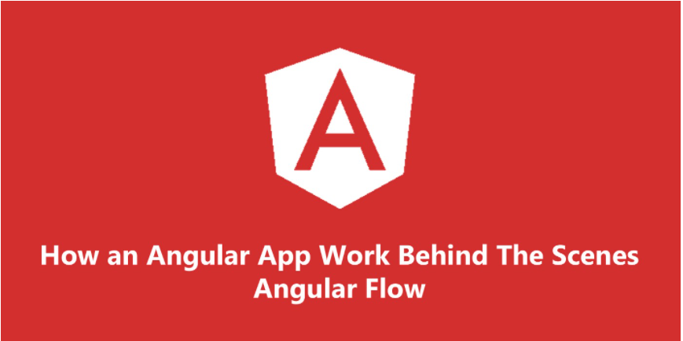
With this great framework and great project structure, there’s a complex flow going behind the scenes. To understand the working in a better way and making the debugging of it easier, it is necessary to understand the flow of the angular app when it is in the development mode.
1. ANGULAR.JSON File
ANGULAR.JSON is the file which has various properties and configuration of your Angular project. This is the file which is first referred by the builder to look for all the paths and configurations and to check which is the main file. I have generated an angular MyFirstApp app by the CLI. Inside the angular.json file of this project, under the build section, you can see the options object as follows

Slide 18
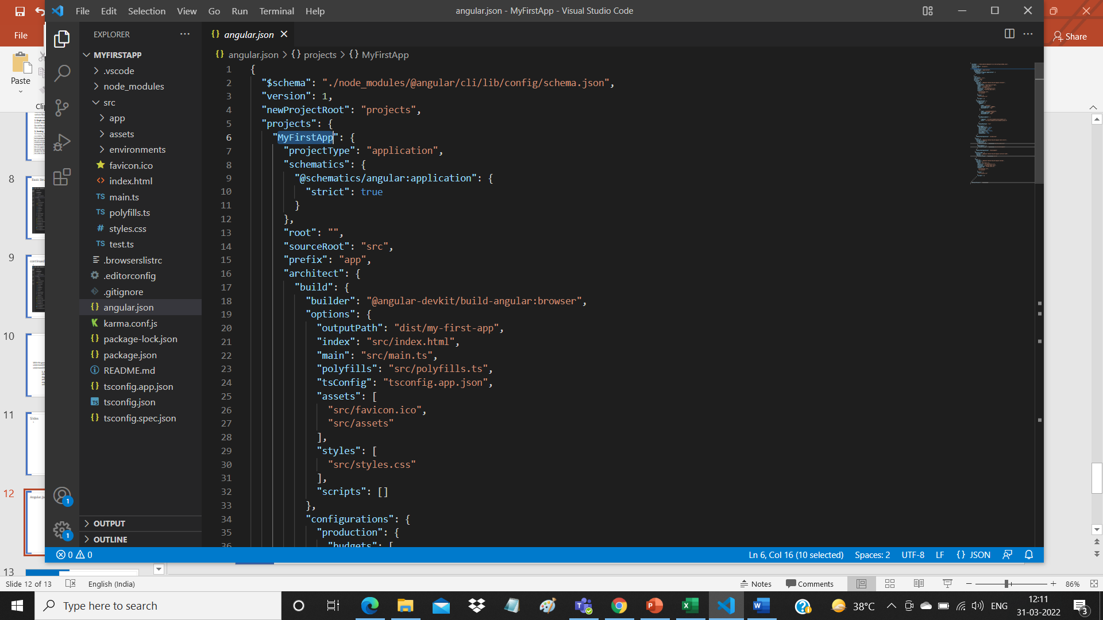
angular.json File
It has a reference to the main.ts file which tells the builder to start the app from there.

Slide 19
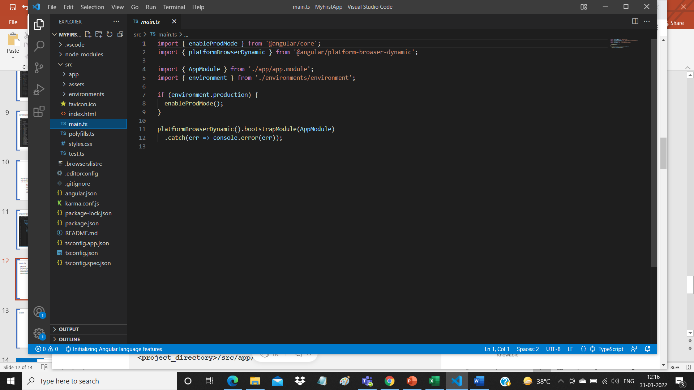
main.ts
2. MAIN.TS
This file acts as the entry point of the application. This entry point is defined in the internals of webpack that is used by Angular to support the modular functionality. The path/name of the main file can be changed but it should also be changed in angular.json file. Main.ts helps in creating the browser environment for the application to run. This is done by:
After this, main.ts file calls the function bootstrapModule(AppModule) which tells the builder to bootstrap the app.
platformBrowserDynamic().bootstrapModule(AppModule)

Slide 20
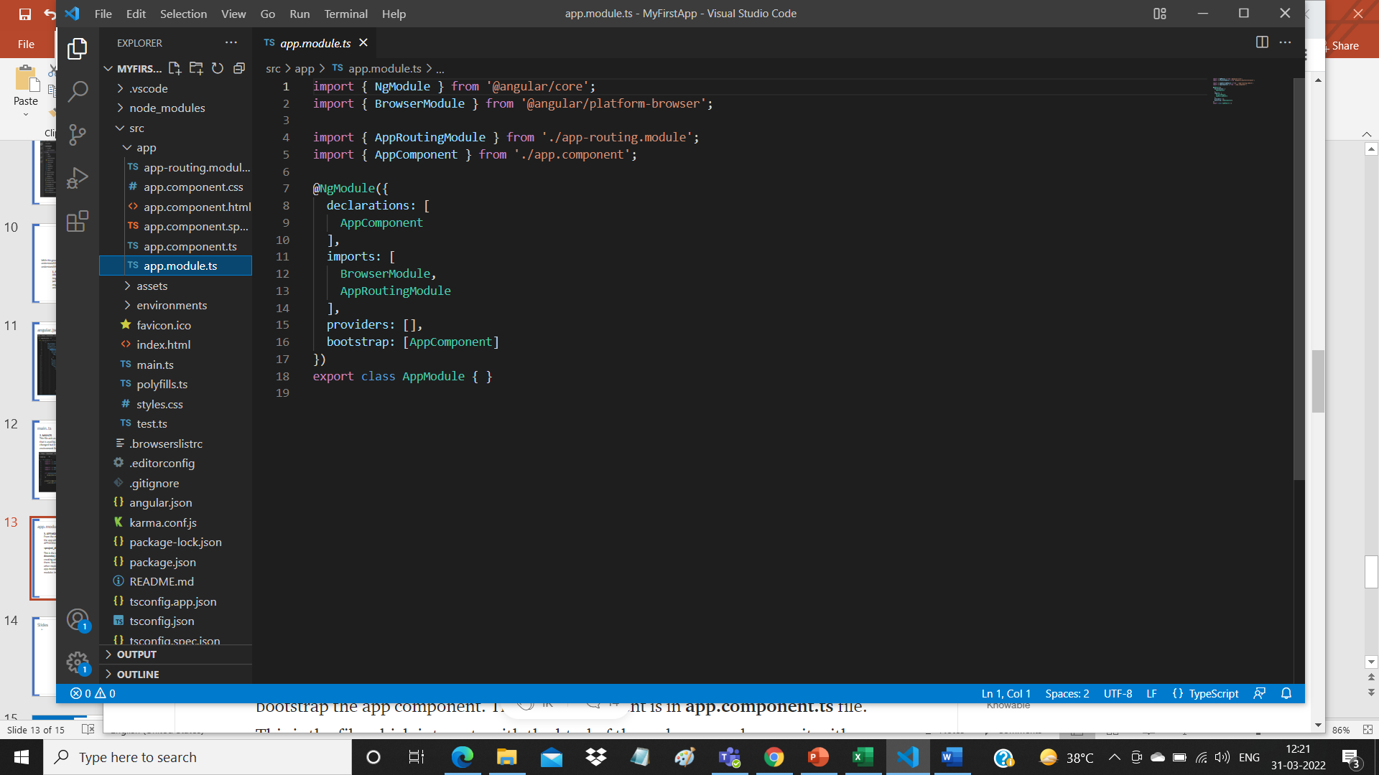
app.module.ts
3. APP.MODULE.TS
From the main.ts file, it is very clear that we are bootstrapping the app with AppModule. This AppModule is defined in APP.MODULE.TS file which is found in
<project_directory>/src/app/app.module.ts
This is the module, created with the @NgModule decorator, which has declarations of all the components we are creating within the app module so that angular is aware of them. Here, we also have imports array where we can import other modules and use in our app. Below is an example of app.module.ts file with a test component declared and two modules imported.

Slide 21
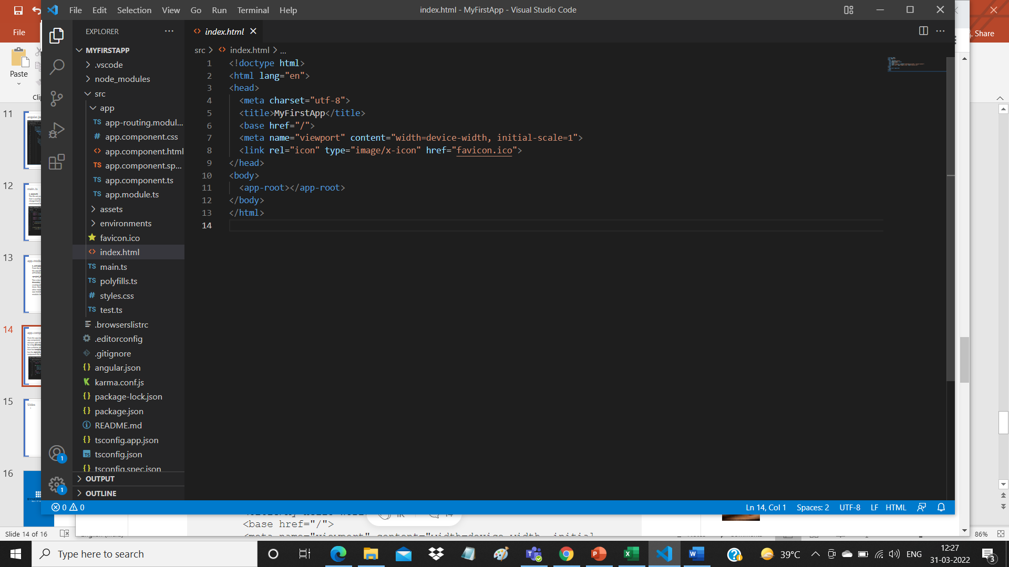
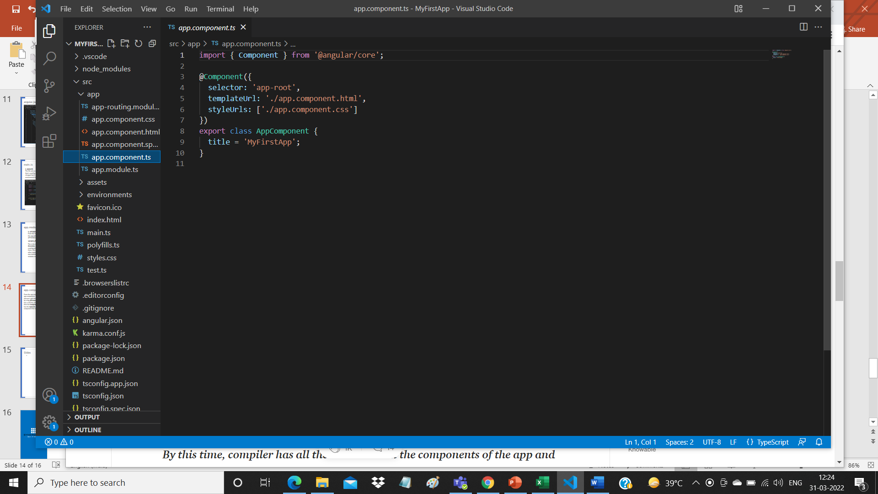
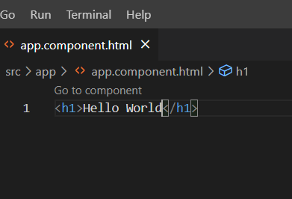
app.component.ts
From the app.module.ts file above, we can clearly see that the module asks to bootstrap the app component. This app component is in app.component.ts file. This is the file which interacts with the html of the webpage and serves it with the data. The component is made by using @Component decorator which is imported from @angular/core. The component has a selector, which is like a custom html tag which we can use to call that component. It then has template or templateUrl which contains the html of the page to be displayed. It also has the styleUrls array where component specific style sheets can be placed. This is how a component file looks

Slide 22
What is the use of Package.json file ?
The package.json file in Angular (and any Node.js-based project) serves several critical purposes. It provides metadata about the project and manages dependencies, scripts, and other important settings. Here's a breakdown of its key uses:
1. Dependency Management
The package.json file lists all the dependencies and devDependencies required for the Angular application to run and be built correctly. Dependencies are grouped into:
"dependencies": Packages that are essential for the application to run. These are the libraries your app needs in production.
"devDependencies": Packages that are needed only for development, like testing tools, linters, compilers, and build tools.

Slide 23
Package Version Meanings
2. Versioning
The package.json helps track the versions of installed packages, using Semantic Versioning (MAJOR.MINOR.PATCH).
This ensures compatibility and makes it easy to manage updates without breaking the application.
For Example: ^16.1.0:
16: The MAJOR version — this is incremented when there are incompatible API changes. A change in this number might require you to adjust your code significantly.
1: The MINOR version — this is incremented when new functionality is added in a backward-compatible manner. It means new features have been added without breaking the existing functionality.
0: The PATCH version — this is incremented when there are backward-compatible bug fixes or minor improvements.

Slide 24
2. The ^ Symbol (Caret)
The caret ^ symbol is a range specifier that allows npm (Node Package Manager) to install the latest compatible version based on the following rules:
^16.1.0 means any version >=16.1.0 but less than 17.0.0 can be installed.
It allows updates to MINOR and PATCH versions as long as the MAJOR version stays the same (i.e., 16.x.x), ensuring backward compatibility.
Example:
^16.1.0 allows versions like:
16.1.1
16.2.0
16.5.3
But it won’t allow versions like:
17.0.0
18.0.0
The tilde ~ symbol in versioning (~16.1.0) also follows Semantic Versioning (SemVer) principles but has a slightly stricter rule compared to the caret ^.
1. Semantic Version Breakdown
For ~16.1.0, the version is again in the format MAJOR.MINOR.PATCH.
16: MAJOR version (breaking changes happen when this number changes).
1: MINOR version (new features, but backward-compatible).
0: PATCH version (backward-compatible bug fixes).

Slide 25
2. The ~ Symbol (Tilde)
The tilde ~ restricts updates to only PATCH versions within a specific MINOR version. Specifically:
~16.1.0 allows updates to any PATCH version >= 16.1.0 but < 16.2.0.
This means you can update only within the 16.1.x range, ensuring the MINOR version is locked.
Example:
~16.1.0 allows versions like:
16.1.1
16.1.5
But it won’t allow versions like:
16.2.0
17.0.0
Summary:
~16.1.0 allows updates only for PATCH releases in the 16.1.x range.
It's more restrictive than ^, which allows updates to both MINOR and PATCH versions

Slide 26
A polyfill is a piece of code (typically JavaScript) used to provide modern functionality on older browsers or environments that do not natively support certain features. Polyfills allow developers to use modern web technologies (like new JavaScript features, APIs, or CSS) while ensuring compatibility with older browsers that lack support for those features.
Why Polyfills Are Needed
Web standards and technologies (such as JavaScript, HTML, and CSS) evolve over time, but not all browsers update at the same pace. Older browsers may not support new features, causing compatibility issues when using modern web applications. Polyfills are a way to "fill in" the gap, providing implementations of newer features so that the code can work seamlessly on all browsers.
Common Use Cases for Polyfills
ES6 (ECMAScript 2015) features: Older browsers might not support newer JavaScript features like Promise, Array.prototype.includes, Object.assign, or async/await.
Modern Web APIs: APIs like fetch(), IntersectionObserver, WebSockets, and others might not be available in older environments.
CSS features: Some CSS features, such as CSS Grid or Flexbox, may not be supported by older browsers.
Example of Polyfills
1. JavaScript Polyfill for Array.prototype.includes()
The includes() method was introduced in ECMAScript 2016 (ES7), but older browsers (like Internet Explorer) do not support it. A polyfill can be used to add this functionality to browsers that don’t natively support it.

Slide 27
Components and Templates

Slide 28
Angular Components
Components are the main building block for Angular applications. Each component consists of:
An HTML template that declares what renders on the page
A TypeScript class that defines behavior
A CSS selector that defines how the component is used in a template
Optionally, CSS styles applied to the template
Creating a component using the Angular CLI
Run the ng generate component <component-name> command, where <component-name> is the name of your new component.
Ex Ng g c mycomponent
ng generate component component-name --skip-tests
Ng g c Emplist –skip-tests

Slide 29
By default, this command creates the following:
A folder named after the component
A component file, <component-name>.component.ts
A template file, <component-name>.component.html
A CSS file, <component-name>.component.css
A testing specification file, <component-name>.component.spec.ts
Mycomponent.ts
Mycomponent.css
Mycomponent.html
Mycomponent.spec.ts

Slide 30
Define the HTML template that the component uses to display information. In most cases, this template is a separate HTML file.
@Component(
{
selector: 'app-mycomponent’,
templateUrl: ‘./mycomponent.component.html’,
})
This Component should be registered in App. Module

Slide 31
Angular Component lifecycle hooks
Sarita Lad

Slide 32
Life Cycle Hooks
When the angular application starts it creates and renders the root component. It then creates and renders its Childrens & their children. It forms a tree of components.
Once Angular loads the components, it starts the process of rendering the view. To do that it needs to check the input properties, evaluate the data bindings & expressions, render the projected content etc. Angular also removes the component from the DOM, when it is no longer needs it.
Angular lets us know when these events happen using lifecycle hooks
The Angular life cycle hooks are nothing but callback function, which angular invokes when a certain event occurs during the component’s life cycle.
For example,
ngOnInit when Angular initializes the component for the first time.
When a component’s input property change, Angular invokes ngOnChanges
If the component is destroyed, Angular invokes ngOnDestroy

Slide 33
Life Cycle Hooks
When the angular application starts it creates and renders the root component. It then creates and renders its Childrens & their children. It forms a tree of components.
Once Angular loads the components, it starts the process of rendering the view. To do that it needs to check the input properties, evaluate the data bindings & expressions, render the projected content etc. Angular also removes the component from the DOM, when it is no longer needs it.
Angular lets us know when these events happen using lifecycle hooks
The Angular life cycle hooks are nothing but callback function, which angular invokes when a certain event occurs during the component’s life cycle.
For example,
ngOnInit when Angular initializes the component for the first time.
When a component’s input property change, Angular invokes ngOnChanges
If the component is destroyed, Angular invokes ngOnDestroy

Slide 34
Angular lifecycle hooks
Here is the complete list of life cycle hooks, which angular invokes during the component life cycle. Angular invokes them when a certain event occurs.
ngOnChanges
ngOnInit
ngDoCheck
ngAfterContentInit
ngAfterContentChecked
ngAfterViewInit
ngAfterViewChecked
ngOnDestroy

Slide 35
Constructor
Life Cycle of a component begins, when Angular creates the component class. First method that gets invoked is class Constructor.
Constructor is neither a life cycle hook nor it is specific to Angular. It is a Javascript feature. It is a method which is invoked, when a class is created.
Angular makes use of a constructor to inject dependencies.
At this point, none of the components input properties are available to use. Neither its child components are constructed. Projected contents are also not available.
Hence there is not much you can do in this method. And also it is recommend not to use it
Once Angular instantiates the class, It kick-start the first change detection cycle of the component.

Slide 36
Constructor
Life Cycle of a component begins, when Angular creates the component class. First method that gets invoked is class Constructor.
Constructor is neither a life cycle hook nor it is specific to Angular. It is a Javascript feature. It is a method which is invoked, when a class is created.
Angular makes use of a constructor to inject dependencies.
At this point, none of the components input properties are available to use. Neither its child components are constructed. Projected contents are also not available.
Hence there is not much you can do in this method. And also it is recommend not to use it
Once Angular instantiates the class, It kick-start the first change detection cycle of the component.

Slide 37
ngOnChanges
The Angular invokes ngOnChanges life cycle hook whenever any data-bound input property of the component or directive changes. Initializing the Input properties is the first task that angular carries during the change detection cycle. And if it detects any change in property, then it raises the ngOnChanges hook. It does so during every change detection cycle. This hook is not raised if change detection does not detect any changes.
Input properties are those properties, which we define using the @Input decorator. It is one of the ways by which a parent communicates with the child component.
In the following example, the child component declares the property message as the input property
@Input() message:string
<app-child [message]="message"></app-child>
The change detector checks if such input properties of a component are changed by the parent component. If it is then it raises the ngOnChanges hook.

Slide 38
ngOnInit
The Angular raises the ngOnInit hook, after it creates the component and updates its input properties. It raises it after the ngOnChanges hook.
This hook is fired only once and immediately after its creation (during the first change detection).
This is a perfect place where you want to add any initialisation logic for your component. Here you have access to every input property of the component. You can use them in http get requests to get the data from the back end server or run some initialization logic etc.
But note that none of child components or projected content are available at this point. Hence any properties we decorate with @ViewChild, @ViewChildren , @ContentChild & @ContentChildren will not be available to use.

Slide 39
ngDoCheck
The Angular invokes the ngDoCheck hook event during every change detection cycle. This hook is invoked even if there is no change in any of the properties.
Angular invokes it after the ngOnChanges & ngOnInit hooks.
Use this hook to Implement a custom change detection, whenever Angular fails to detect the changes made to Input properties. This hook is particularly useful when you opt for the Onpush change detection strategy.
The Angular ngOnChanges hook does not detect all the changes made to the input properties.

Slide 40
ngAfterContentInit
ngAfterContentInit Life cycle hook is called after the Component’s projected content has been fully initialized. Angular also updates the properties decorated with the ContentChild and ContentChildren before raising this hook. This hook is also raised, even if there is no content to project.
The content here refers to the external content injected from the parent component via Content Projection.
The Angular Components can include the ng-content element, which acts as a placeholder for the content from the parent as shown below
<h2>Child Component</h2>
<ng-content></ng-content> <!-- placehodler for content from parent -->
<h1>Parent Component</h1>
<app-child> This <b>content</b> is injected from parent</app-child>
During the change detection cycle, Angular checks if the injected content has changed and updates the DOM.
This is a component only hook.

Slide 41
ngAfterContentChecked
ngAfterContentChecked Life cycle hook is called during every change detection cycle after Angular finishes checking of component’s projected content. Angular also updates the properties decorated with the ContentChild and ContentChildren before raising this hook. Angular calls this hook even if there is no projected content in the component
This hook is very similar to the ngAfterContentInit hook. Both are called after the external content is initialized, checked & updated. Only difference is that ngAfterContentChecked is raised after every change detection cycle. While ngAfterContentInit during the first change detection cycle.
This is a component only hook.

Slide 42
ngAfterViewInit
ngAfterViewInit hook is called after the Component’s View & all its child views are fully initialized. Angular also updates the properties decorated with the ViewChild & ViewChildren properties before raising this hook.
The View here refers to the template of the current component and all its child components & directives.
This hook is called during the first change detection cycle, where angular initializes the view for the first time
At this point all the lifecycle hook methods & change detection of all child components & directives are processed & Component is completely ready
This is a component only hook.

Slide 43
ngAfterViewChecked
The Angular fires this hook after it checks & updates the component’s views and child views. This event is fired after the ngAfterViewInit and after that during every change detection cycle
This hook is very similar to the ngAfterViewInit hook. Both are called after all the child components & directives are initialized and updated. Only difference is that ngAfterViewChecked is raised during every change detection cycle. While ngAfterViewInit during the first change detection cycle.
This is a component only hook.

Slide 44
ngOnDestroy
This hook is called just before the Component/Directive instance is destroyed by Angular
You can Perform any cleanup logic for the Component here. This is the correct place where you would like to Unsubscribe Observables and detach event handlers to avoid memory leaks.
How to Use Lifecycle Hooks?
Import Hook interfaces
Declare that Component/directive Implements lifecycle hook interface
Create the hook method

Slide 45
The Order of Execution of Life Cycle Hooks
On Component Creation
OnChanges
OnInit
DoCheck
AfterContentInit
AfterContentChecked
AfterViewInit
AfterViewChecked

Slide 46
When the Component with Child Component is created
OnChanges
OnInit
DoCheck
AfterContentInit
AfterContentChecked
Child Component -> OnChanges
Child Component -> OnInit
Child Component -> DoCheck
Child Component -> AfterContentInit
Child Component -> AfterContentChecked
Child Component -> AfterViewInit
Child Component -> AfterViewChecked
AfterViewInit
AfterViewChecked

Slide 47
Directives
Sarita Lad

Slide 48
Directives in Angular:
Directives in Angular is basically a JavaScript or TypeScript based class. You typically declare it as @directive, there are 3 directives in Angular.
Component directives :form the main class. It possesses the details about how the component should be instantiated, processed and utilized at runtime.
Structural Directives
As far as a structure directive is concerned, it is associated with manipulating the dom elements. You will find an asterisk (*) prefix before the directive. We can take *ngFor and *ngIf as examples here.
Attribute Directives
When it comes to altering the behavior and look of the dom element, you turn to attribute directives.

Slide 49
Structural Directives in Angular
Structural directives are responsible for the Structure and Layout of the DOM Element. It is used to hide or display the things on the DOM. Structural Directives can be easily identified using the ‘*’. Every Structural Directive is preceded by a ‘*’ symbol.
*ngIf,*ngIf else,*ngFor,*ngSwitch
ngIf is used to display or hide the DOM Element based on the expression value assigned to it. The expression value may be either true or false.
Syntax:
<div *ngIf="boolean"> </div>
In the above Syntax, boolean stands for either true or false value. Hence, it leads to 2 valid syntaxes as below :
<div *ngIf="true"> </div>
<div *ngIf="false"> </div>

Slide 50
Angular ngFor directive
Angular ngFor directive iterates over a collection of data like an array, list, etc, and creates an HTML element for each of the items from an HTML template. It helps us to build lists or tables to display tabular data in a nice way.The ngFor also exports several local variables like Index, First, Last, odd, even & trackby.etc. In this article, we will learn the following
Syntax of ngFor
<html-element ngFor="let <item> of <items>;”>
<html-Template></html-Template>
</html-element>
<ul>
<li *ngFor="let movie of movies">
{{ movie.title }} - {{movie.director}}
</li>
</ul>
Using ngFor

Slide 51
Attribute Directives
Syntax:
<element [ngStyle] = "typescript_property">
Syntax:
<element [ngClass] = "typescript_property">

Slide 52
Nested ngFor Loop Example
<tr *ngFor="let employee of employees;">
<td>{{employee.name}}</td>
<td>{{employee.email}}</td>
<td>
<table class='table table-sm '>
<tbody>
<tr *ngFor="let skill of employee.skills;">
<td>{{skill.skill}}</td>
<td>{{skill.exp}}</td>
</tr>
Finding the Index
<tr *ngFor="let movie of movies; let i=index;">
<td> {{i}} </td>
<td>{{movie.title}}</td>
<td>{{movie.director}}</td>
<td>{{movie.cast}}</td>
<td>{{movie.releaseDate}}</td>
</tr>

Slide 53
Parameter Decorator
Sarita Lad

Slide 54
how Angular Passes the data to the child component?
The Angular Components communicate with each other using @Input Decorator.
In Angular, the Parent Component can communicate with the child component by setting its Property. To do that the Child component must expose its properties to the parent component. The Child Component does this by using the @Input decorator
In the Child Component
Import the @Input module from @angular/Core Library
Mark those property, which you need data from the parent as input property using @Input decorator
In the Parent Component
Bind the Child component property in the Parent Component when instantiating the Child

Slide 55
@Input Decorator
The @Input Decorator is used to configure the input properties of the component. This decorator as also supports change tracking.
When you mark a property as input property, then the Angular injects values into the component property using Property Binding. The Property Binding uses the [] brackets. The Binding Target (Property of the child component) is placed inside the square brackets. The Binding source is enclosed in quotes. Property binding is one way from Component to the Target in the template
Example:
<child-component [count]=Counter></child-component>
Here, we are using count property, which is a property of the child Component inside the square bracket. We bind it to Counter property of the Parent Component.
Remember square bracket represents the Property Binding in Angular.

Slide 56
@Input Decorator
The @Input Decorator is used to configure the input properties of the component. This decorator as also supports change tracking.
When you mark a property as input property, then the Angular injects values into the component property using Property Binding. The Property Binding uses the [] brackets. The Binding Target (Property of the child component) is placed inside the square brackets. The Binding source is enclosed in quotes. Property binding is one way from Component to the Target in the template
Example:
<child-component [count]=Counter></child-component>
Here, we are using count property, which is a property of the child Component inside the square bracket. We bind it to Counter property of the Parent Component.
Remember square bracket represents the Property Binding in Angular.

Slide 57
@Input Decorator
Various ways to use @Input Decorator
We used input @Input Decorator to mark the property in child component as input property. There are two ways you can do it Angular.
Using the @Input decorator to decorate the class property
Using the input array meta data of the component decorator
You can Alias the input property and use the aliased name the parent component as shown below
export class ChildComponent {
@Input('MyCount') count: number;
}
<child-component [MyCount]=ClickCounter></child-component>

Slide 58
@Input Decorator
Detecting the Input changes
We looked at how to pass the data from parent to the child using @Input decorator and property binding.
Passing the data to child component is not sufficient, the child Component needs to know when the input changes so that it can act upon it.
Using Input Setter will see here :
There are two ways of detecting when input changes in the child component in Angular
Using OnChanges LifeCycle Hook see when we learn Life cycle hooks
Using Input Setter

Slide 59
@Input Decorator
Using Input Setter
We can use the property getter and setter to detect the changes made to the input property as shown below
In the Child Component create a private property called _count
private _count = 0;
Create getter & setter on property count and attach @Input Decorator. We intercept the input changes from the setter function and log them to console
@Input()
set count(count: number)
{
this._count = count;
console.log(count);
}
get count(): number { return this._count; }

Slide 60
Angular Pass data from Child to parent component
There are three ways in which the parent component can interact with the child component
Listens to Child Event
Uses Local Variable to access the child
Uses a @ViewChild to get the reference to the child component
Parent listens for child event
The Child Component exposes an EventEmitter Property. This Property is adorned with the @Output decorator. When Child Component needs to communicate with the parent it raises the event. The Parent Component listens to that event and reacts to it.
EventEmitter Property
To Raise an event, the component must declare an EventEmmitter Property. The Event can be emitted by calling the .emit() method

Slide 61
@Output Decorator
Using the EventEmitter Property gives the components ability to raise an event. But to make that event accessible from parent component, you must decorate the property with @Output decorator
Declare a property of type EventEmitter and instantiate it
Mark it with a @Output Decorator
@Output() newItemEvent = new EventEmitter<string>();
addNewItem(value: string) {
this.newItemEvent.emit(value);
}
2. Raise the event passing it with the desired data
<button type="button" (click)="addNewItem(newItem.value)">Add to parent's list</button>
In the Parent Component
Bind to the Child Component using Event Binding and listen to the child events <app-student (newItemEvent)="addItem($event)"></app-student></div>
Define the event handler function
addItem(newItem: string) {
this.items.push(newItem);
}

Slide 62
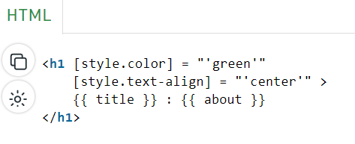
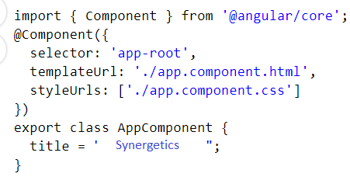
String Interpolation
String Interpolation in Angular 8 is a one-way data-binding technique that is used to transfer the data from a TypeScript code to an HTML template (view). It uses the template expression in double curly braces to display the data from the component to the view. String interpolation adds the value of a property from the component to the HTML template view.
Syntax:
{{ component_property }}

Slide 63
Template Reference Variable
The Template reference variable is a reference to any DOM element, component or a directive in the Template. We can use it elsewhere in the template. We can also pass it to a method in the component. It can contain a reference to elements like h1, div, etc
We declare Template reference variables using # followed by the name of the variable ( #variable). We can also declare them using #variable="customer" when the component/directive defines a customer as the exportAs Property.
For Example
HTML Element
<input type="text" #firstName>

Slide 64
Example
<p>
<label for="firstName">First Name</label>
<input (keyup)="0" type="text" #firstName id="firstName">
</p>
<p>
<label for="lastName">Last Name</label>
<input (keyup)="0" type="text" #lastName id="lastName">
</p>
<b>Welcome {{firstName.value}} {{lastName.value}} </b>
<p>
<button (click)="sayHello(firstName, lastName)"> Say Hello</button>
</p>
Add this to app.component.ts
sayHello(firstName, lastName) {
alert('Hello '+firstName.value+' '+ lastName.value)
}

Slide 65
Thank You
This is all about How Angular works!!!

